Slide 1
Digital portfolio
K.Tamizhselvi
astvu32132124u18069
Bsc computer science
Muthurangam govt arts college-thiruvalluvar university

Slide 2
My BEAUTISION PORTFOLIO
“Beauticians Add sparkle not Just to faces,
but to lives”

Slide 3
AgeNda
Portfolio design and Layout Tools and Technologies Problem Statement Features and Functionality Project Overview Results and Screenshots
ConclusionGithub Link

Slide 4
Problem Statement
❖ Beauticians face challenges in showcasing their skills and services professionally and accessibly. ❖ Relying only on local salons or word of mouth limits visibility and customer reach. ❖ Without a structured digital portfolio, demonstrating expertise and styles effectively becomes difficult.
❖ Wider audience (clients, recruiters, event planners, beauty enthusiasts) cannot be reached easily.

Slide 5
PROJECT OVERVIEW
Digital portfolio / platform to showcase beauty services and works.
Main idea: Highlight creativity 💄 makeup skills ✂️ hairstyling & beauty achievements.
Goal:🌍 Connect with clients who value professional beauty services.

Slide 6
PROJECT OVERVIEW
Project contains
• About Me – introduction and professional journey in beauty & styling • Profile – passion, skills, specialization (makeup, skincare, hair, etc.) • Projects – portfolio of client makeovers & styles • Contact Me – connect and collaborate for services or events

Slide 7
WHO ARE THE END USERS?
💋 Beauty Lovers & Enthusiasts – people who enjoy exploring new beauty trends and looks. 🎓 Students & Learners – individuals interested in beauty education and training. 👩‍💼 Clients & Event Planners – customers seeking professional beauticians for weddings, parties, or personal services. 🌐 General Audience (Online Viewers) – anyone browsing beauty portfolios for inspiration.

Slide 8
TOOLS AND TECHNIQUES USED
💄 Tools Used
✨ Techniques
Makeup kits → foundation, lipsticks, brushes, sponges. Hair styling equipment → dryer, straightener, curler, scissors, combs. Skincare products → cleansers, masks, moisturizers, serums. Photography tools → camera & lighting for portfolio
Makeup → contouring, highlighting, bridal, HD & airbrush. Hairstyling → braiding, curling, straightening, coloring. Skincare → facials, exfoliation, treatments. Client consultation → skin analysis, personal styling advice. Hygiene & safety → professional salon standards

Slide 9
PORTFOLIO DESIGH AND LAYOUT
Section included:
◆ 🏠 Home / About Me – Introduction and professional journey in beauty & styling ◆ 💇 Services / Projects – Images of completed works (makeup, hair styling, skincare) ◆ ✨ Skills – Technical expertise and creative strengths in beauty & grooming ◆ 📞 Contact – Easy way for clients to book appointments or inquiries Responsive Layout – Works smoothly on both mobile & desktop for better accessibility

Slide 10
FEATURES AND FUNCTIONALITY
🔗 Navigation Bar – Smooth scrolling between sections (About, Services, Skills, Portfolio, Contact) 💄 Service Showcase – Display beauty services (makeup, hair styling, skincare) with images & details. 🖼️ Portfolio Gallery – Before & after client transformations for better presentation.
⭐ Client Reviews & Ratings – Build trust and credibility. 📅 Booking Form – Allows clients to book appointments easily. 📞 Contact Form – Simple way to connect and collaborate

Slide 11
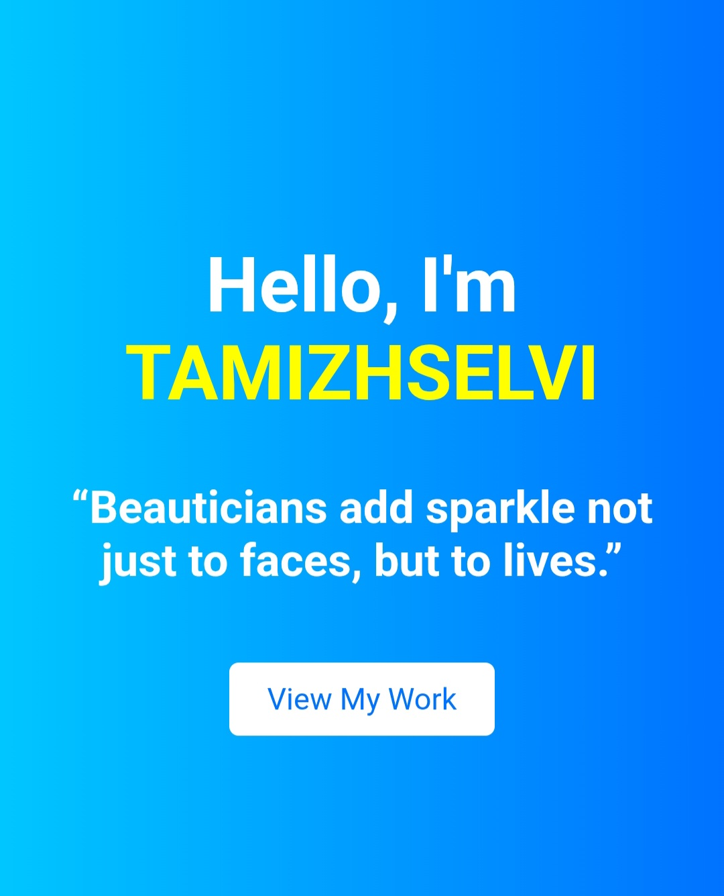
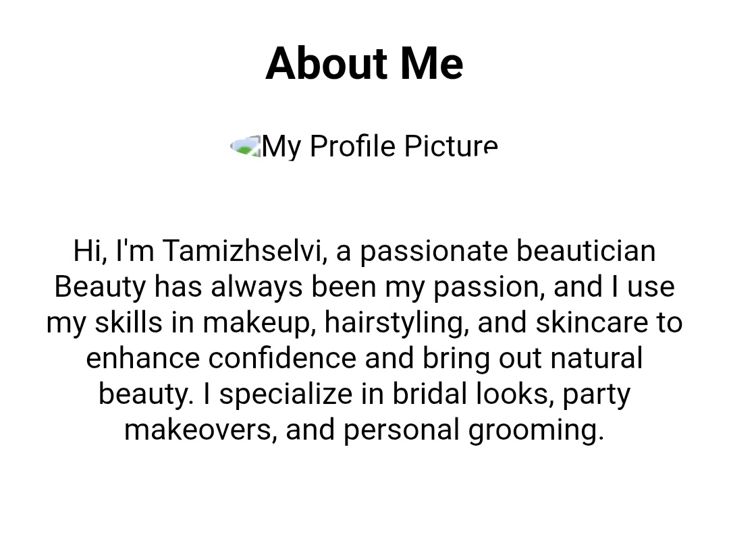
Results and screenshot

Slide 12
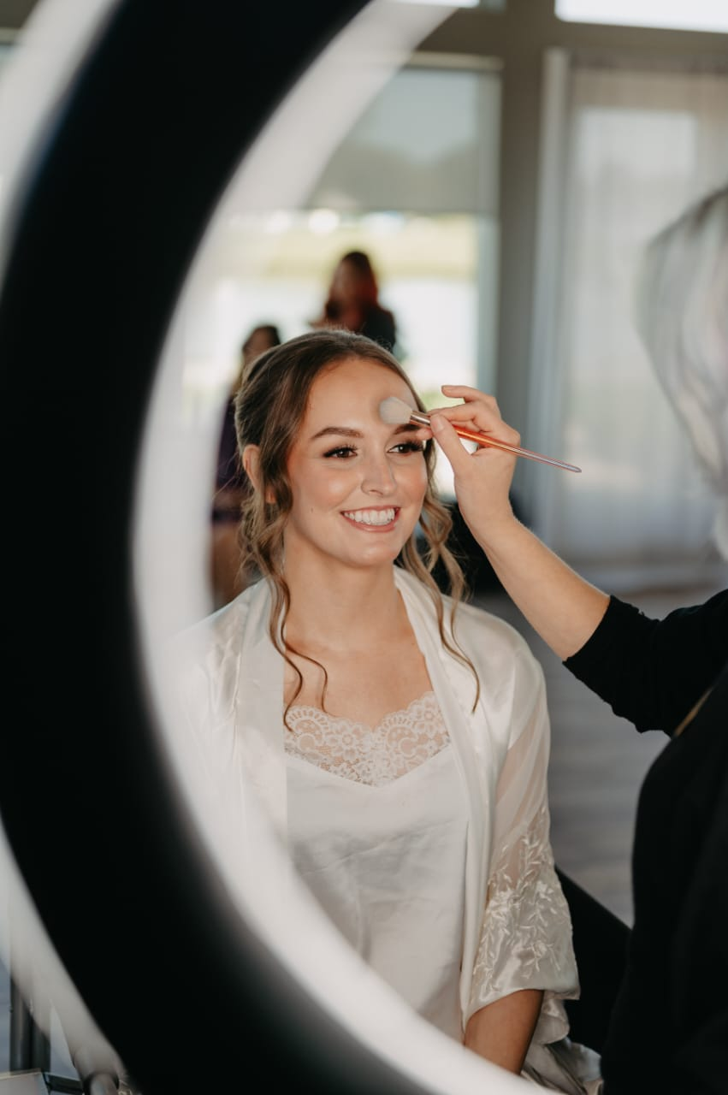
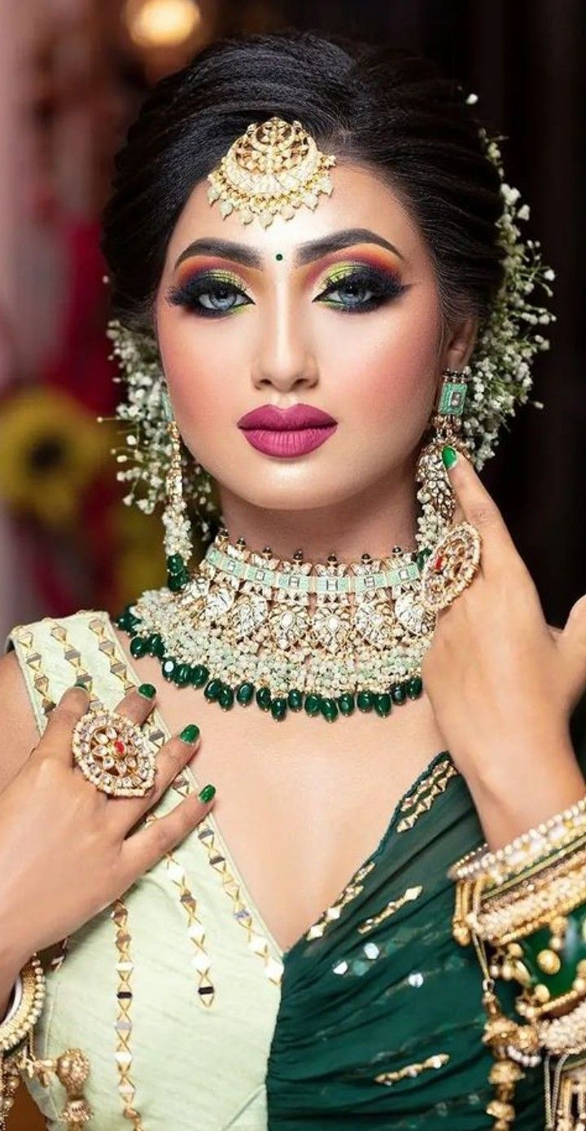
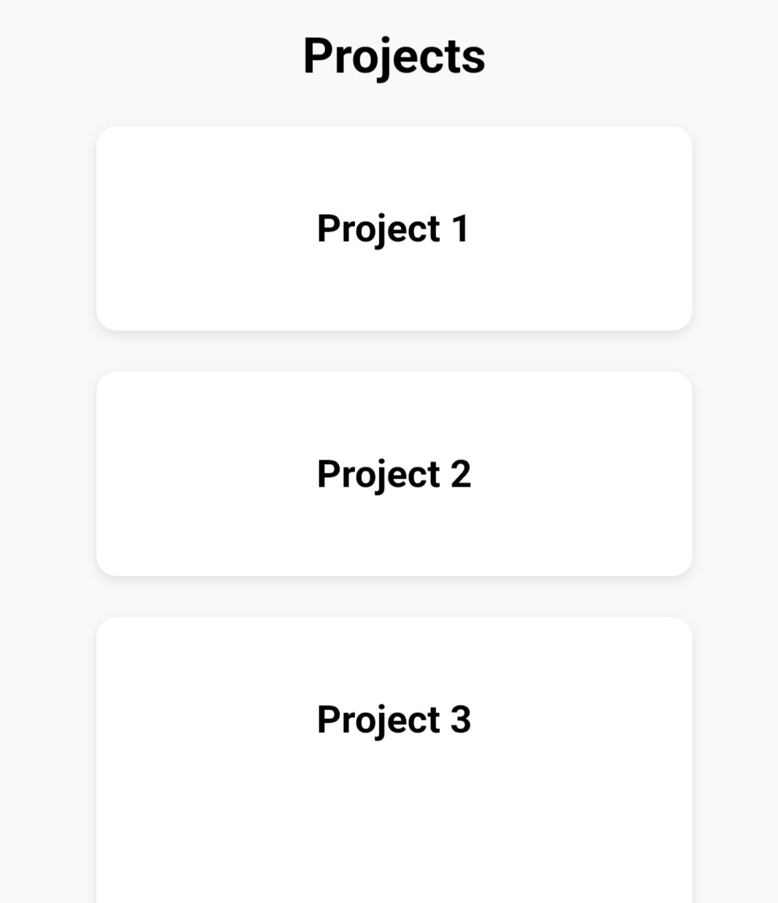
Results and screenshot

Slide 13
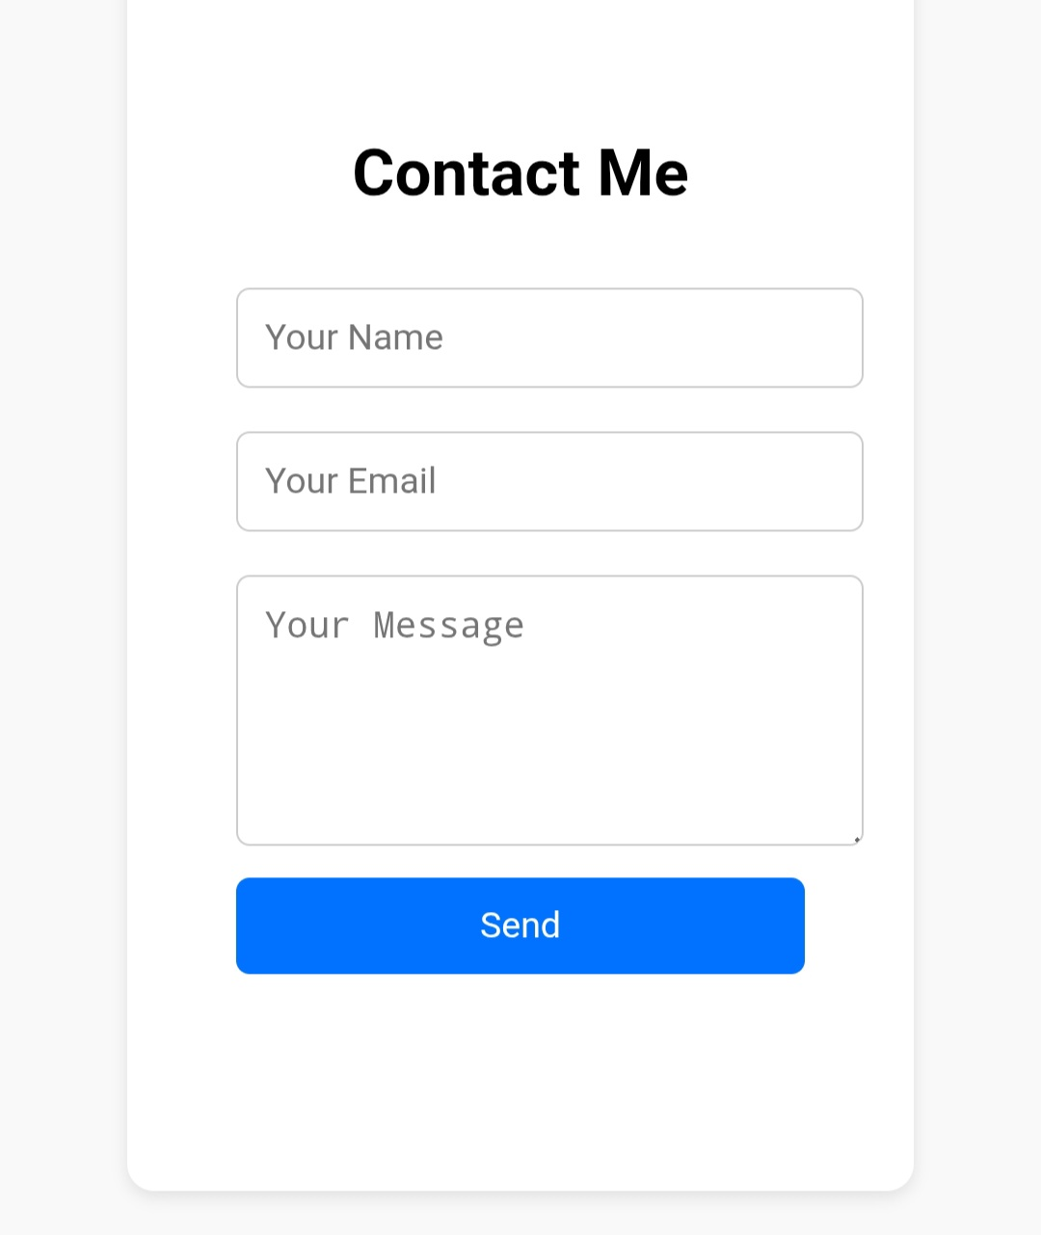
Result and screenshot

Slide 14
CONCLUSION
HIGHLIGHTS OF MY PROJECT
Built a personal portfolio for showcasing beauty services.
Used creative layouts and visuals to highlight work.
Added sections: Home, About, Services, Portfolio, and Contact.
Simple, attractive, and user-friendly design.

Slide 15
CONCLUSION
FINAL SUMMARY
The project reflects my skills in makeup, hairstyling, and skincare presentation. Helps me display my work in a professional and accessible way. A valuable step for career growth, visibility, and new opportunities.

Slide 16
CONCLUSION
BENEFITS TO THE SOCIETY
Allows beauticians to share their work online and reach more clients.
Provides easy access for customers, event planners, and recruiters.
Inspires other beauticians to build their own portfolios and showcase their skills.

Slide 17
Thank you

